Slide 1
Workcase 3
Виконали: Чех І. В. та Дзизиль Д.Є.

Slide 2
Cloning your virtual working OS

Slide 3
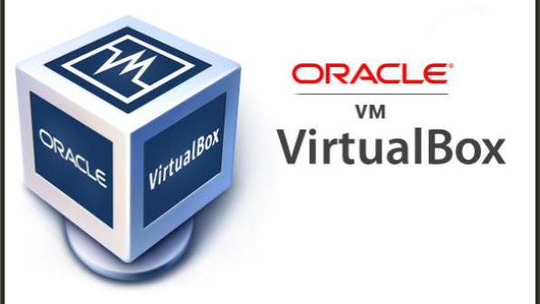
01
'Clone a virtual machine'
Виконав студент: Дзизиль Д.Є.

Slide 4
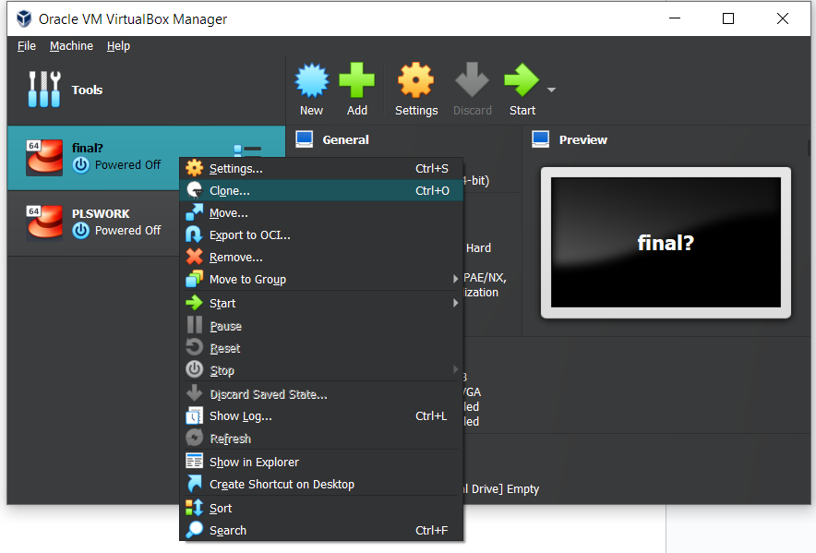
Cloning
Виконав студент: Дзизиль Д.Є.
01
In order to clone a virtual machine, you must:
Start the Virtual Box program;
Right-click on the machine to be cloned and click “Clone”;
Next, you need to configure the clone: name the cloned machine, choose the folder where it will be stored and other options;

Slide 5
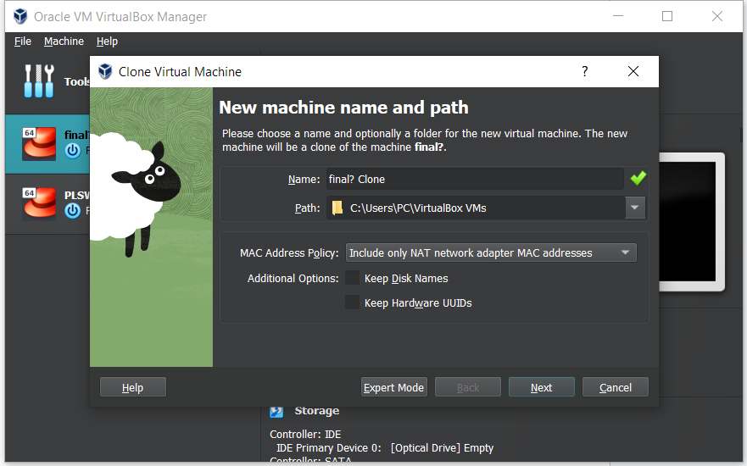
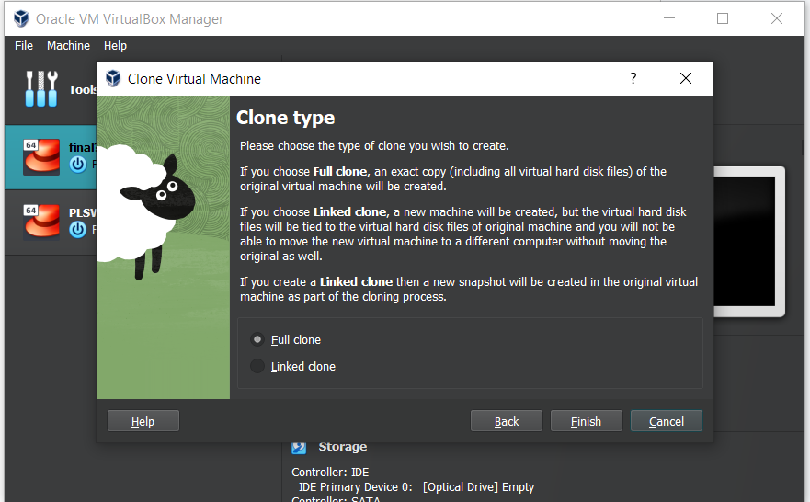
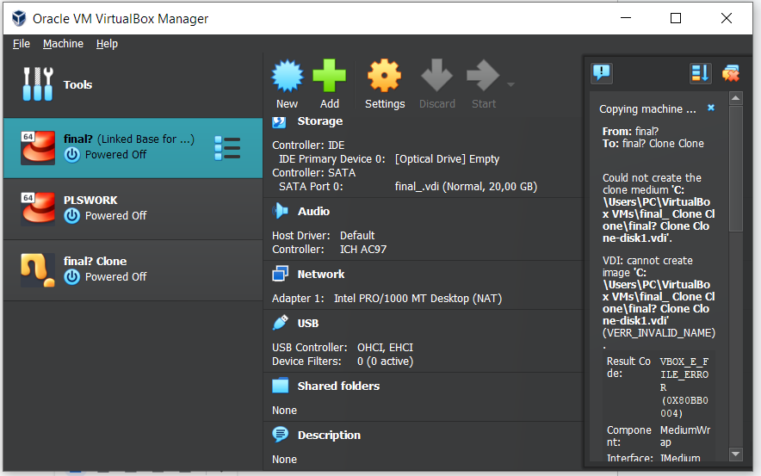
Виконав студент: Дзизиль Д.Є.
01

Slide 6
01
'Export'
Виконав студент: Дзизиль Д.Є.

Slide 7
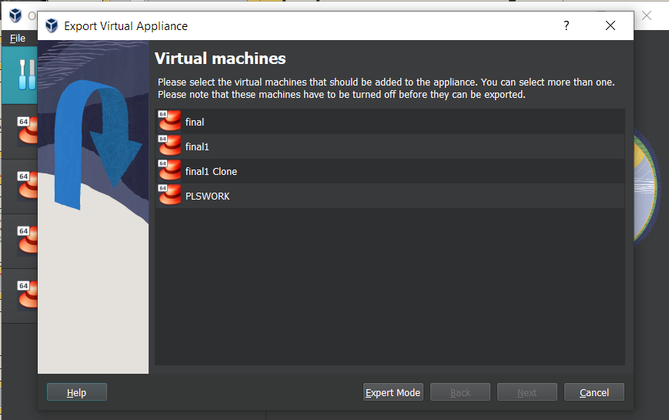
Export
Виконав студент: Дзизиль Д.Є.
01
In order to export a virtual OS, you must:
Select the virtual OS you want to export;
Click on the "Tools" button, then on "Export";
Next, it is necessary to configure the export parameters of the virtual OS;

Slide 8
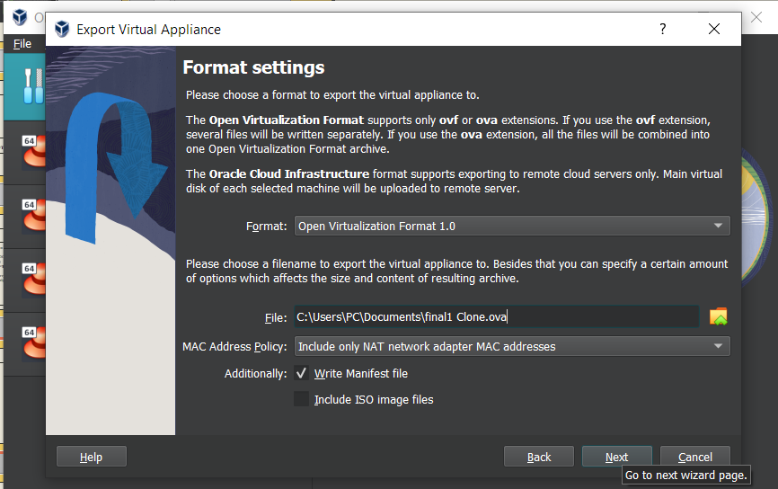
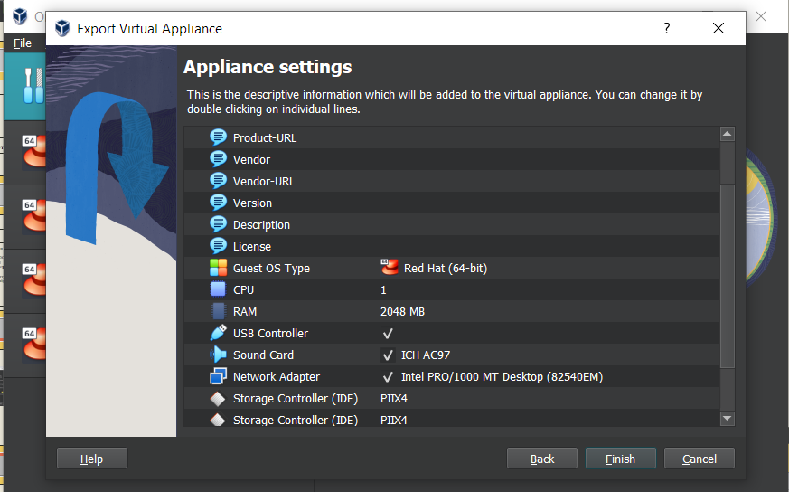
Виконав студент: Дзизиль Д.Є.
01

Slide 9
Describe what types of organization of network connections are supported in the environment of virtual machines, what is the peculiarity of each of them:

Slide 10

Network Address Translation (NAT):
Feature: In NAT mode, VirtualBox creates an internal network for virtual machines and uses NAT to establish connections with the external network. Each virtual machine is assigned an IP address in this internal network, and access to the internet and other resources of the external network is facilitated through NAT.
Purpose: It is used when you want your virtual machines to have access to the internet or other external network resources but do not require public IP addresses.
Виконав студент: Чех І. В.

Slide 11

Network bridge:
Feature: In Bridged mode, the virtual machine is connected directly to the physical network, like other computers on your local network. It receives its own IP address from the local network and can communicate with other devices on this network.
Purpose: Used when you need a virtual machine to be fully visible and accessible on the local network like any other physical computer.
Виконав студент: Чех І. В.

Slide 12

Virtual host adapter (Host-only):
Feature: In Host-only mode, virtual machines can communicate only with each other and with the host system, but do not have access to an external network or the Internet. They get IP addresses from the internal virtual network.
Purpose: Used when you need to create an isolated network for internal testing or development and you do not want the virtual machines to have access to the external network.
Виконав студент: Чех І. В.

Slide 13
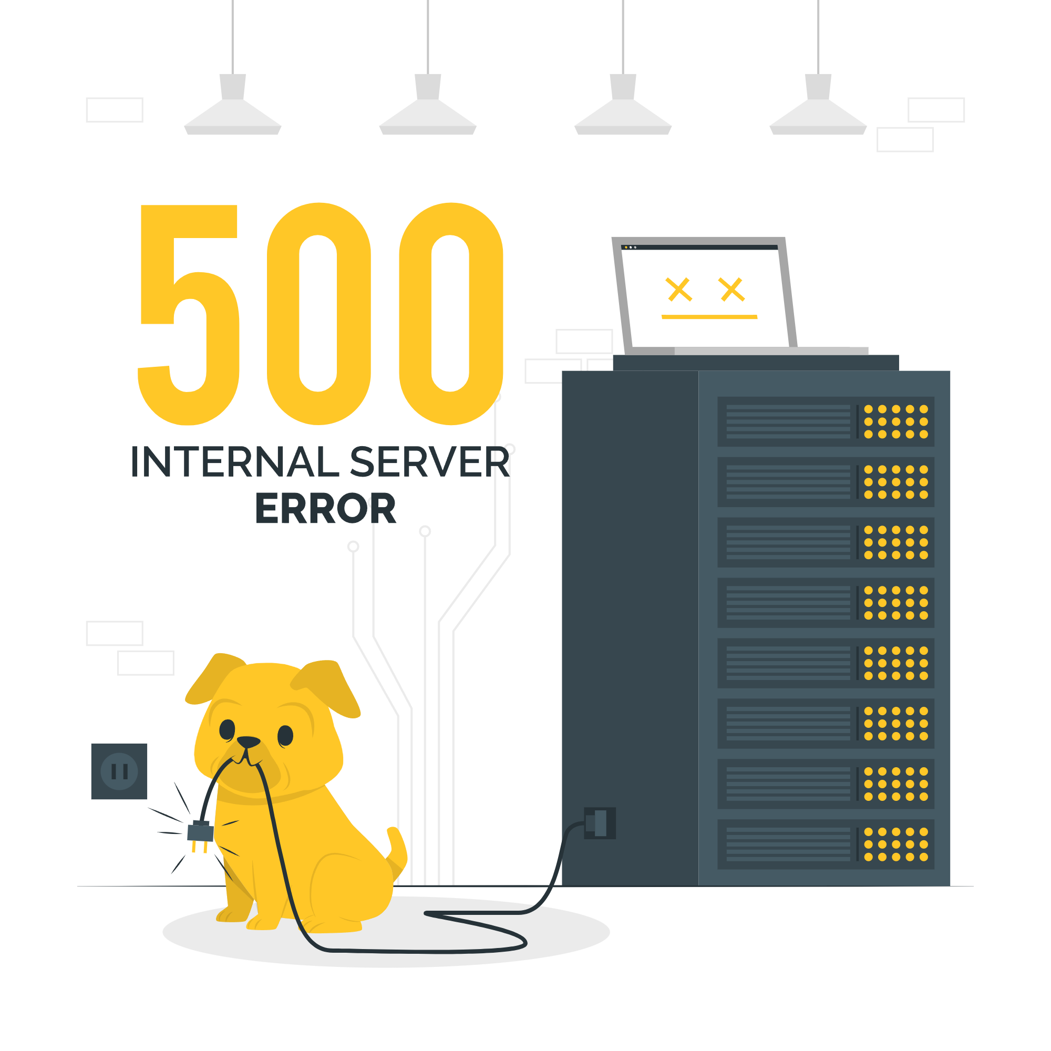
Internal network:
Feature: In Internal Network mode, virtual machines connect to an internal network and can only communicate with each other and with the host system, if such a network is configured. They do not have access to an external network or the Internet.
Purpose: Used when you need to create a closed internal network for virtual machines that must communicate with each other but must not be accessible from the outside.
Виконав студент: Чех І. В.

Slide 14
03
'Configuring network settings'
Виконав студент: Чех. І.В.

Slide 15
Network settings
Виконав студент: Чех. І.В.
03
There are the following commands for configuring the network:
Ifconfig - This command displays the current settings of network interfaces, such as IP address, subnet mask, and more. It also allows you to change network settings;
Ip — is a more modern alternative to "ifconfig";
Route (route) — this command displays and allows you to change routing tables;

Slide 16
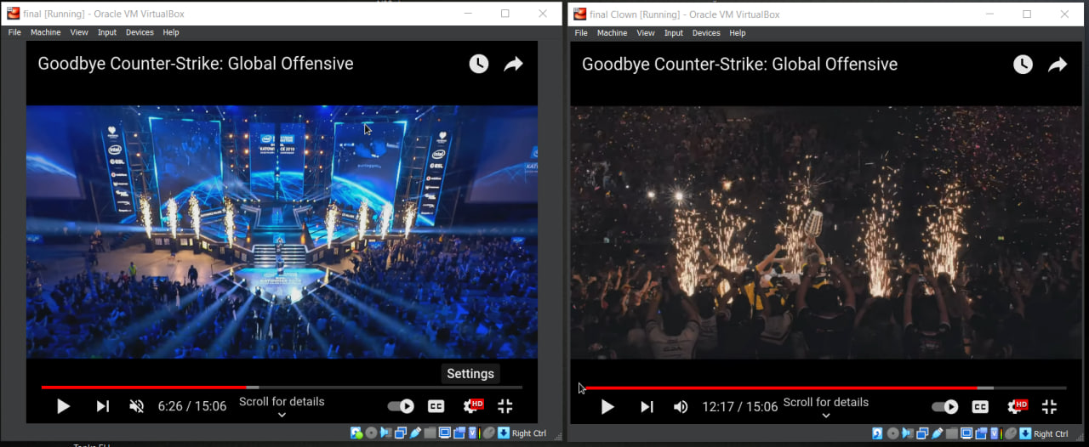
Network settings
Виконав студент: Чех. І.В.
03

Slide 17
03
'Inter-OS Messaging'
Виконав студент: Чех. І.В.

Slide 18
Exchange of messages between OS
Виконав студент: Чех. І.В.
03
First, start one virtual machine listening on a specific port: Nc –l –p 12345;
On another virtual machine, you need to write the following command:
Nc <IP address> 12345;
After entering this command, you will be able to enter a text message and it will go to the other machine
To exit press “Ctrl+C”;

Slide 19
03
‘Network Folder'
Виконав студент: Чех. І.В.

Slide 20
Network Folder
Виконав студент: Чех. І.В.
03
Install the "cifs-utils" package if it is not already installed: sudo apt install cifs-utils
Create a directory in which you will mount the shared folder: mkdir ~/shared_folder
Mount the shared folder using the "mount.cifs" command. Replace <IP_address> and <folder_name> with the appropriate values: sudo mount -t cifs //<IP_address>/<folder_name> ~/shared_folder -o username=<your_name>,password=<your_password>
Now that you've set up a shared folder, you can copy files between that folder and your home directories on both operating systems.

